Slide 1
Data Scientist – Vidio Question 4
Created by Fuad Maulana

Slide 2
The Question
How could we know the platform that user keenly used to watch?
How do you convince us that user are keenly watch on that platform? (for example, user keenly watch on web platform, because ...)

Slide 3
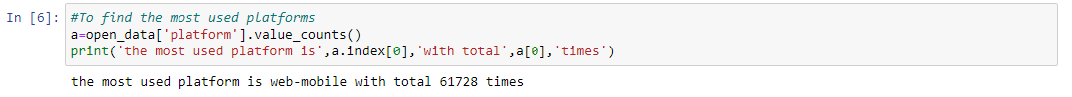
Keenly Used Platforms
open_data[‘platform’] is the data in column ‘platform’. While value_counts() to find out the number of values that exist in the data. Output is the number of values that have been sorted from largest number. a.index[0] to find first index and a[0] to find out the largest number of the first index. So it is known that the most keenly used platform is the mobile web with a total of 61728 times.

Slide 4
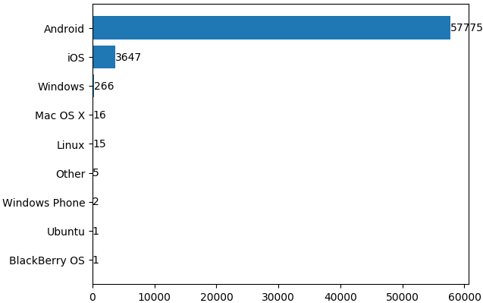
List The Number of OS Names on Mobile Web
It can be seen that significantly more users use Android than any other OS where the number of Android usage is 57775 times.

Slide 5
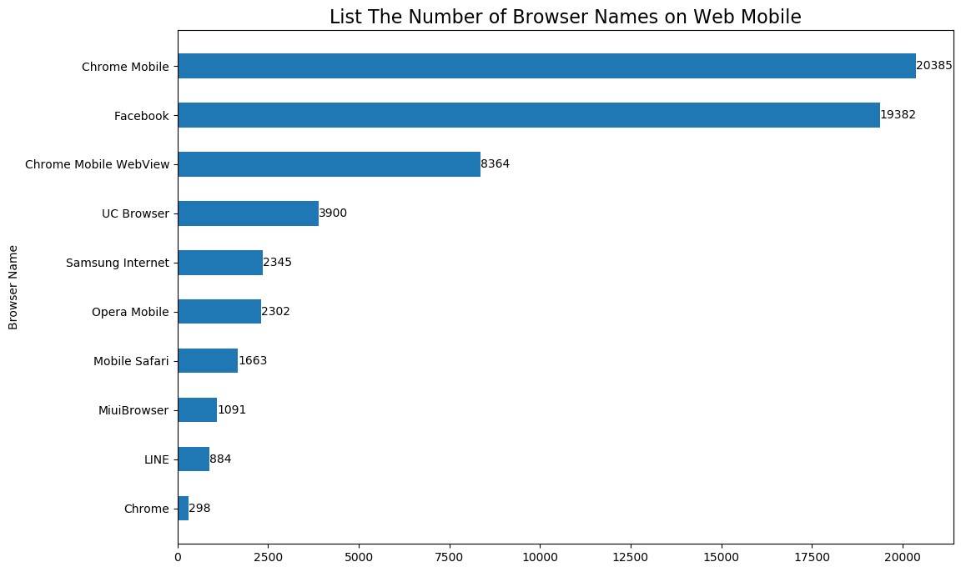
Top 10 Browser Names
It can be seen that many users use browsers from mobile apps, such as Chrome Mobile, UC Browser, Opera Mobile, Mobile Safari, MiuiBrowser, and others. The most used browser is Chrome Mobile with 20385 times.

Slide 6
Conclusion
The platform that is often used by users is the mobile web. Because many users are using mobile, especially Android. Of course, mobile can be used anywhere and anytime, so many people watch videos using mobile. It is also known that many mobile users watch using a web browser compared to watching using a mobile app such as vidio app and others.

